Slide 1
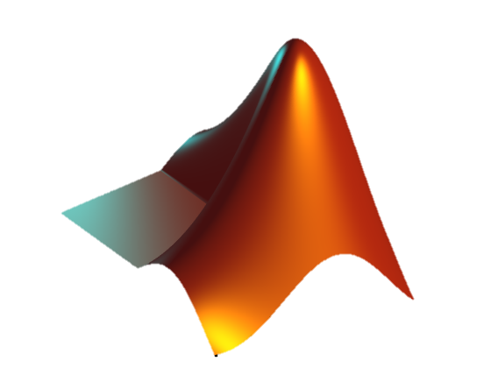

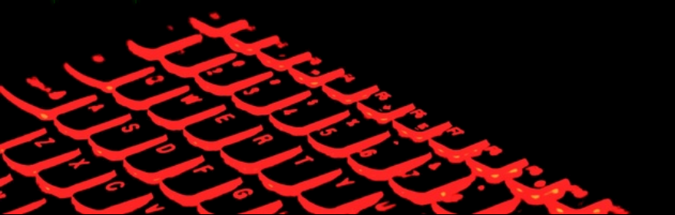
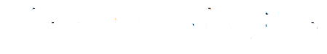
Matlab: diving deeper

Slide 2
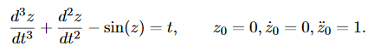
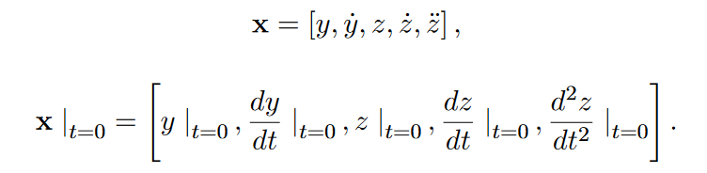
Demystifying ODEs
Unknowns:
Initial Conditions:

Slide 3
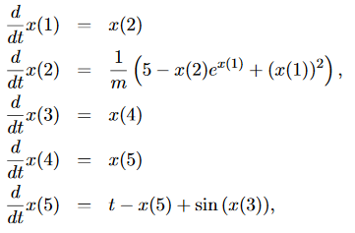
Demystifying ODEs
Input file:

Slide 4
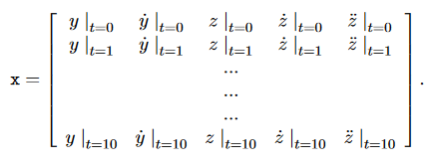
Demystifying ODEs
Solution:

Slide 5
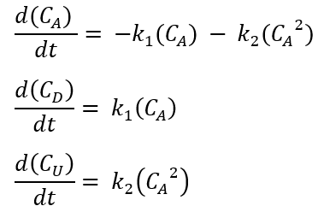
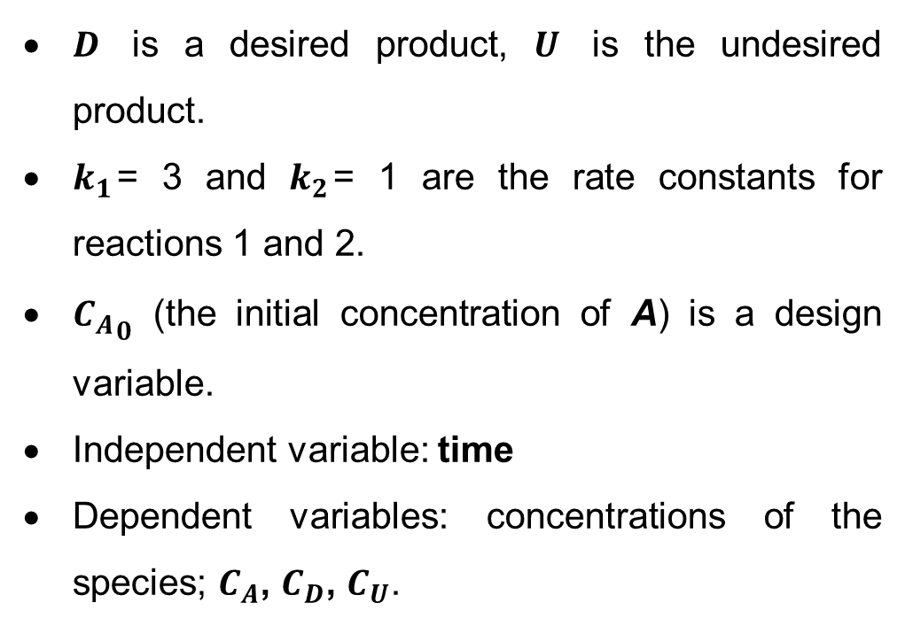
Your turn
System of reactions inside a batch reactor (see Word document for full description)
$D$ is a desired product, $U$ is the undesired product.
$k_{1}$= 3 and $k_{2}$= 1 are the rate constants for reactions 1 and 2.
${C_{A}}_{0}$ (the initial concentration of A) is a design variable.
Independent variable: time
Dependent variables: concentrations of the species; $C_{A}$, $C_{D}$, $C_{U}$.

Slide 6
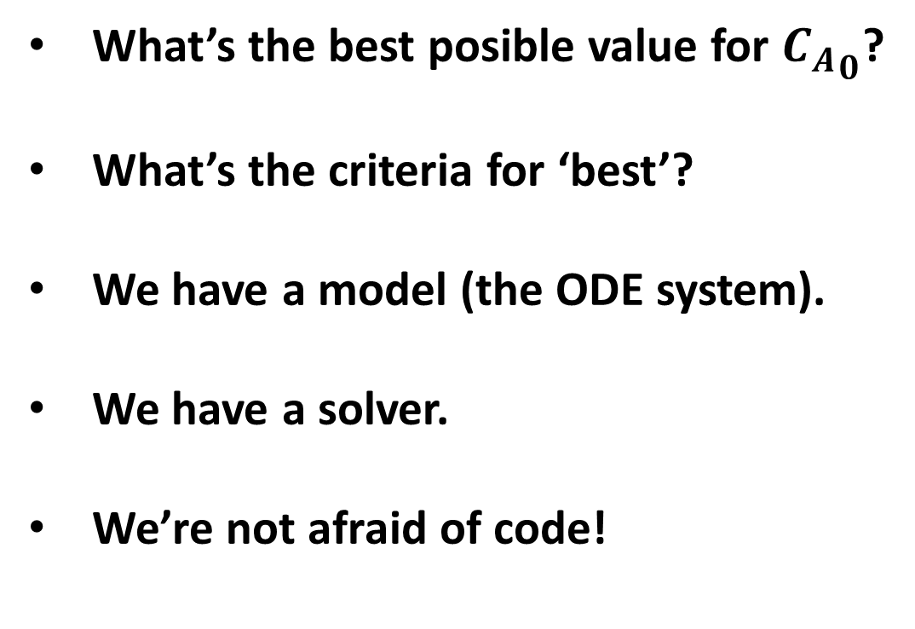
Taking it a step further…
What’s the best posible value for ${C_{A}}_{0}$?
What’s the criteria for ‘best’?
We have a model (the ODE system).
We have a solver.
We’re not afraid of code!

Slide 7
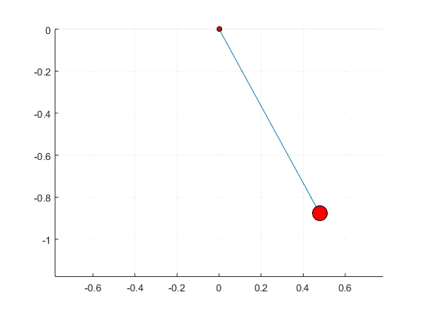
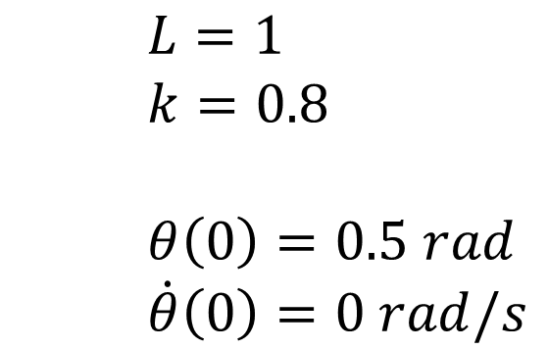
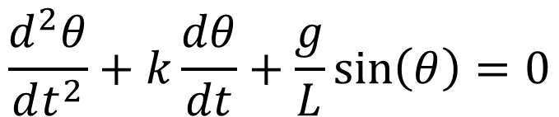
Let’s build this!
$$\frac{d^{2}θ}{dt^{2}}+k\frac{dθ}{dt}+\frac{g}{L}\sin\left(θ\right)=0$$
$L=1$
$k=0.8$
$θ\left(0\right)=0.5 rad$
$\dot{θ}\left(0\right)=0 rad/s$

Slide 8
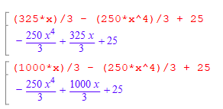
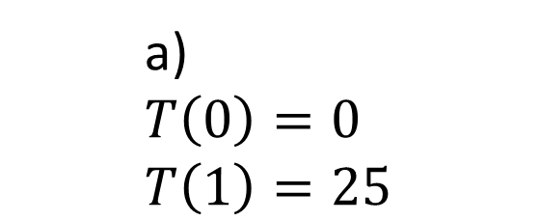
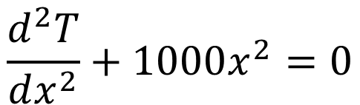
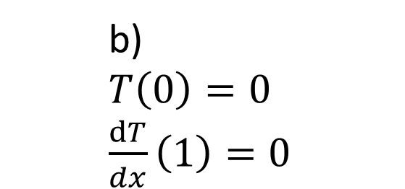
Symbolic Calculus
dsolve
$$\frac{d^{2}T}{dx^{2}}+1000x^{2}=0$$
mupad
a) $T\left(0\right)=0$
$T\left(1\right)=25$
b) $T\left(0\right)=0$
$\frac{dT}{dx}\left(1\right)=0$

Slide 9
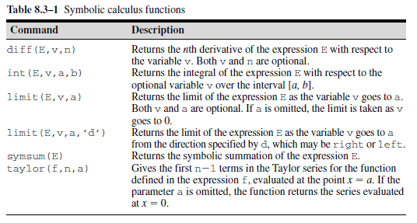
Symbolic Calculus
A Concise Introduction to Matlab (Palm, 2008).

